Slide 1
Keyboard & Typing
A talk about keyboard layout, input methods and languages
My2ndAngelic

Slide 2
About this talk
Mechanical layout
QWERTY only
Some designs might alter a little bit
Collection showcase
Totally not sponsored

Slide 3
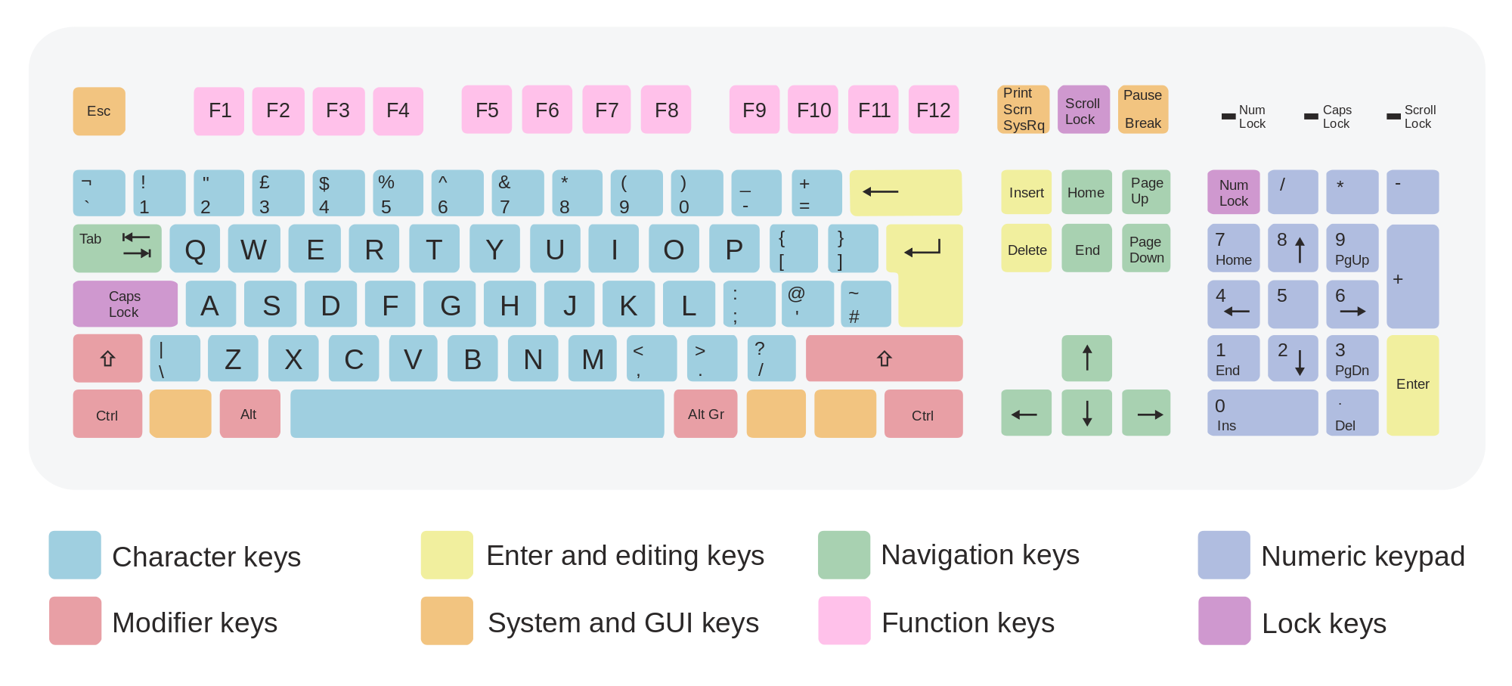
A typical keyboard
Notes:
English_UK

Slide 4
Keyboard layouts
ANSI (American National Standards Institute)
ISO (International Organization for Standardization)
JIS (Japanese Industry Standard)

Slide 5
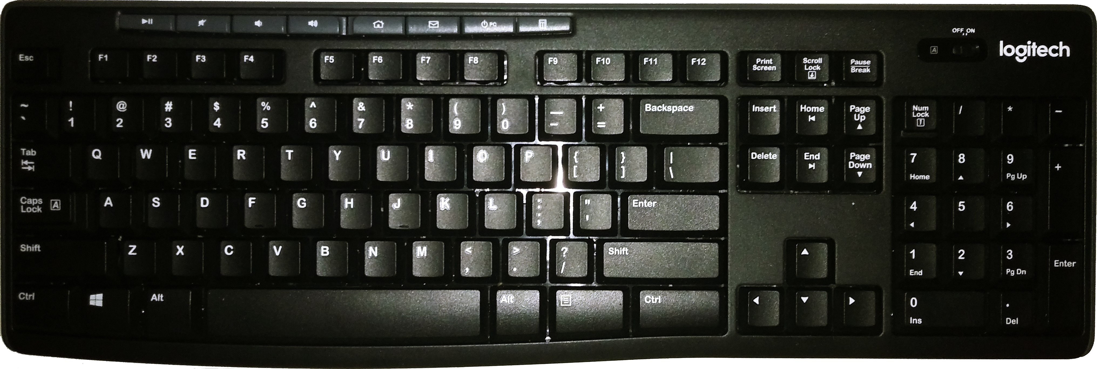
ANSI

Slide 6
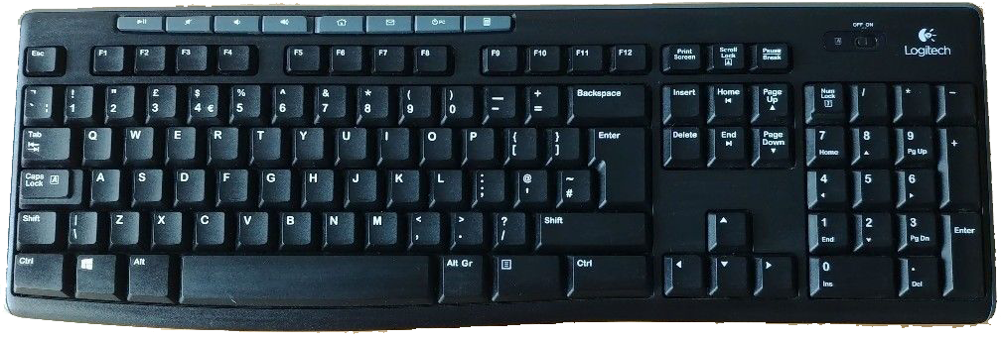
ISO

Slide 7
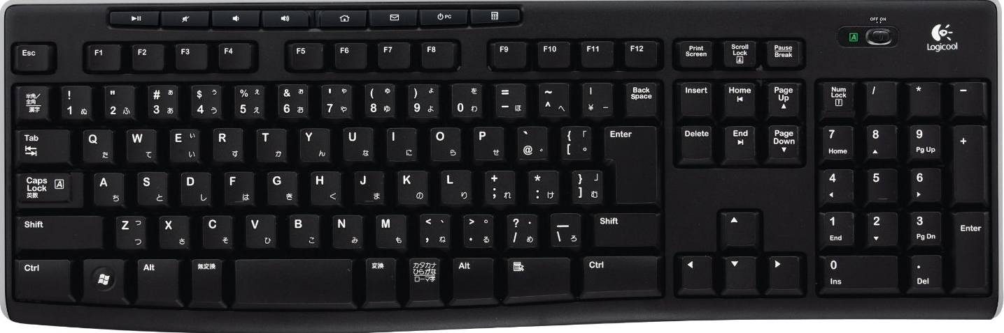
JIS

Slide 8
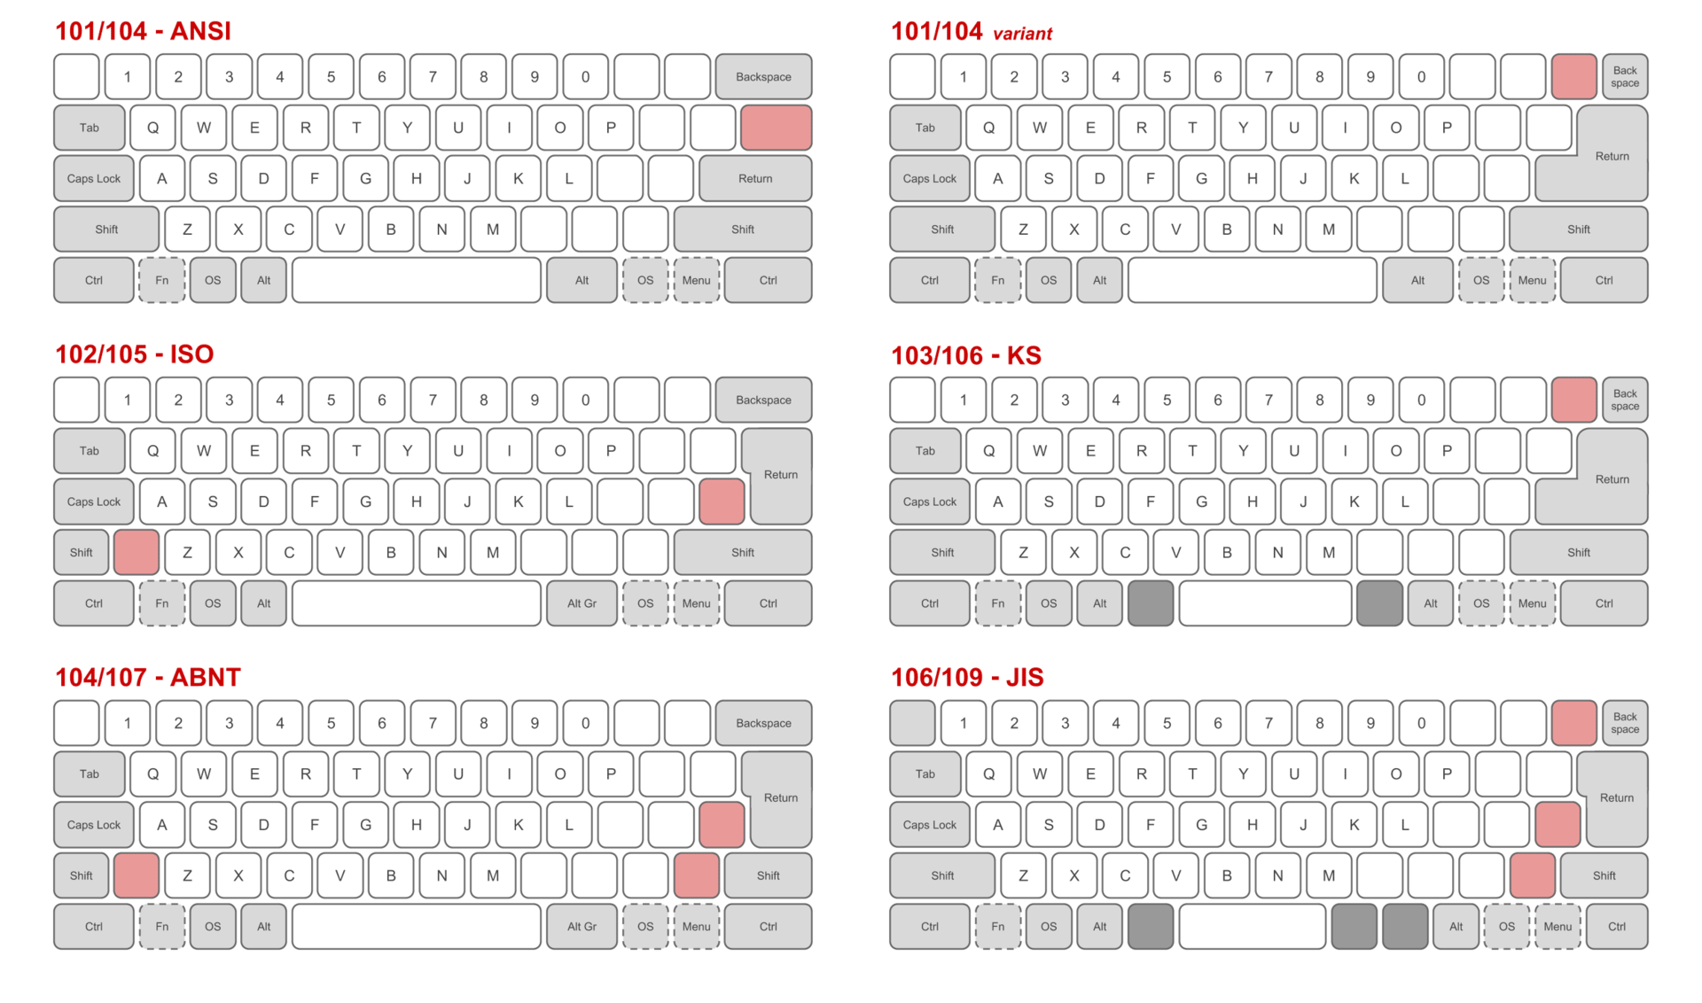

Slide 9
Why you need to know
Learning foreign languages
Living in another country
Not all languages share the same keyboard layouts
Each language has their own history of computer and text encoding
Ergonomic reasons

Slide 10
Input Method Editor
IME stands for input method editors
A software that modified input key to specific key
Each language has their own IME, input styles and input engine

Slide 11
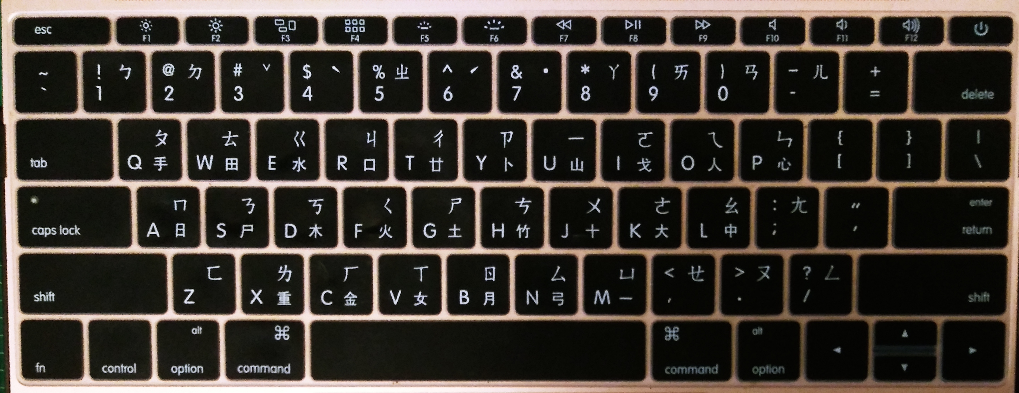

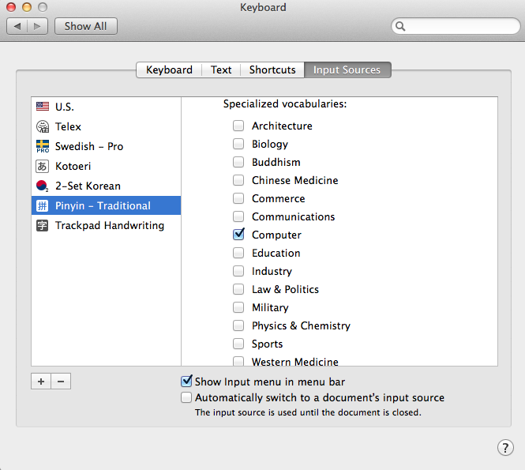
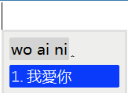
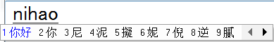
Chinese
Microsoft/Sogou IME
Dictionary required, very extensive
Hanzi conversion
Pinyin/Cangjie/Zhuyin and more
Notes:
RIME IME

Slide 12

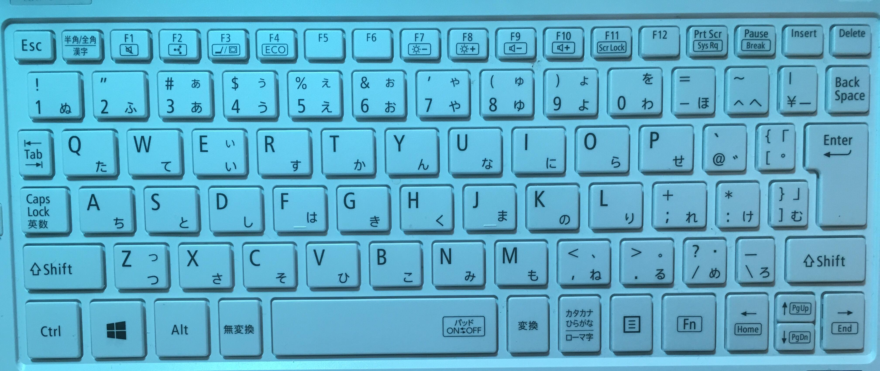
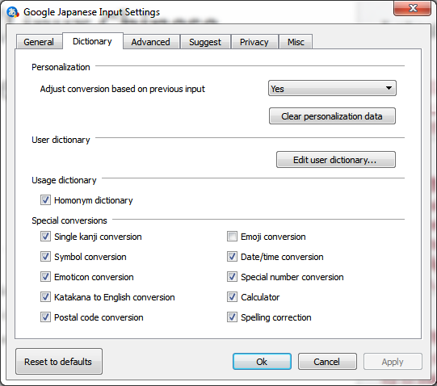
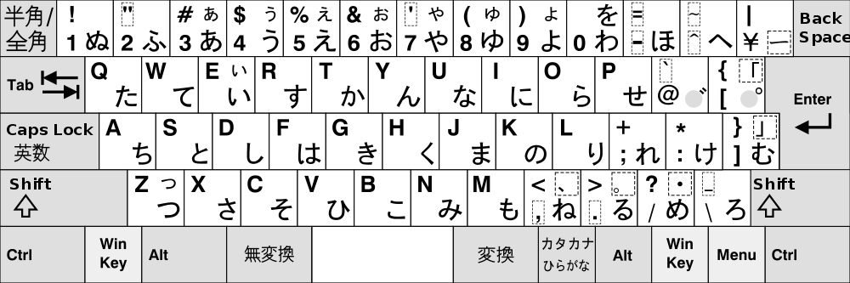
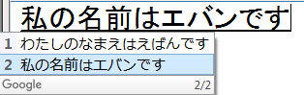
Japanese
Microsoft/Google IME
Dictionary required, but not extensive
Key conversations
Kana-Kanji conversion
Kana/Romaji input

Slide 13
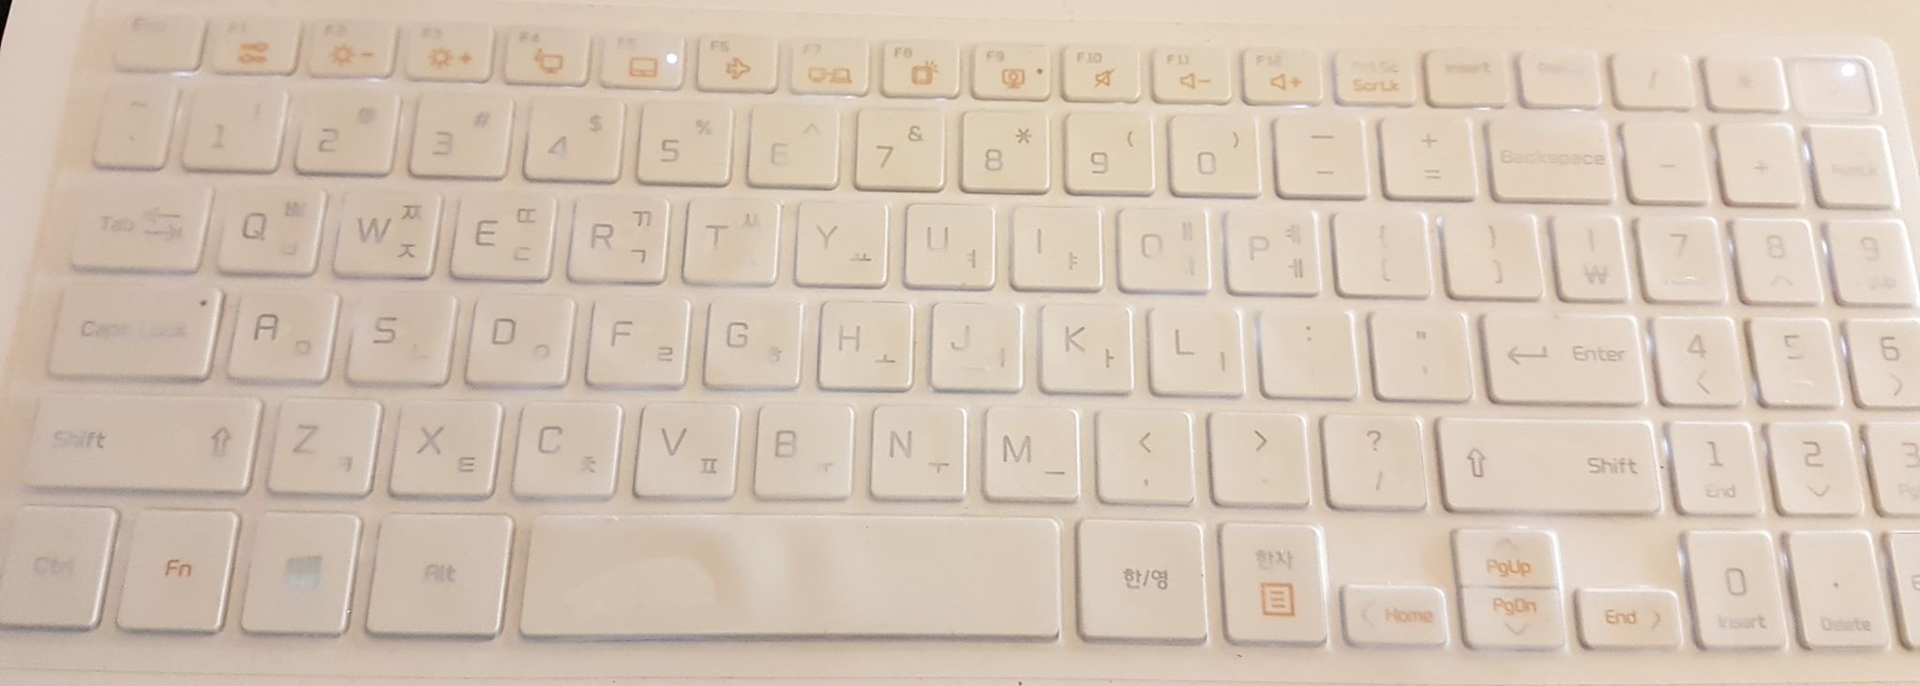
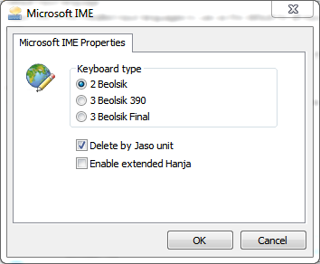
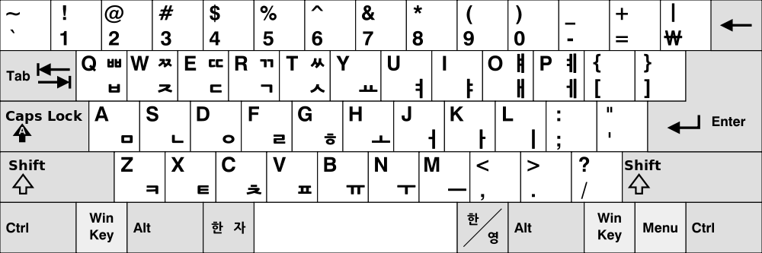
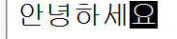
Korean
Default IME
No dictionary required (?)
Alt Gr to change mode from English to Korean input
2 Beolsik

Slide 14
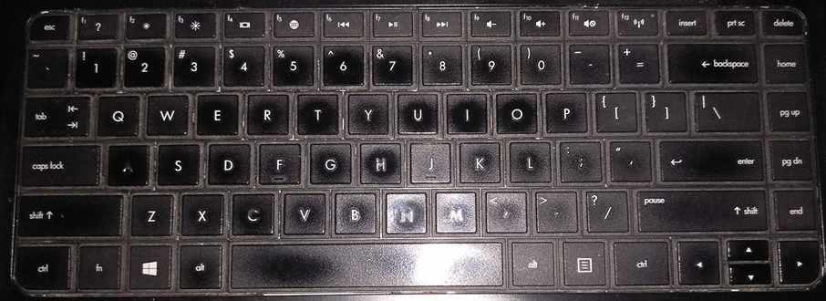
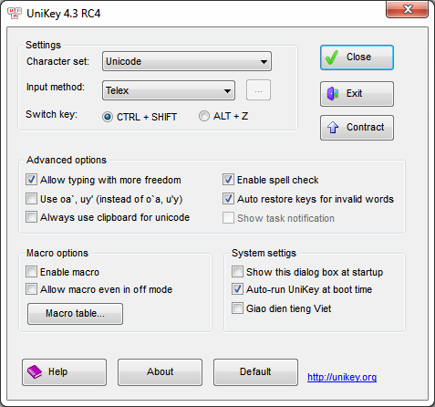
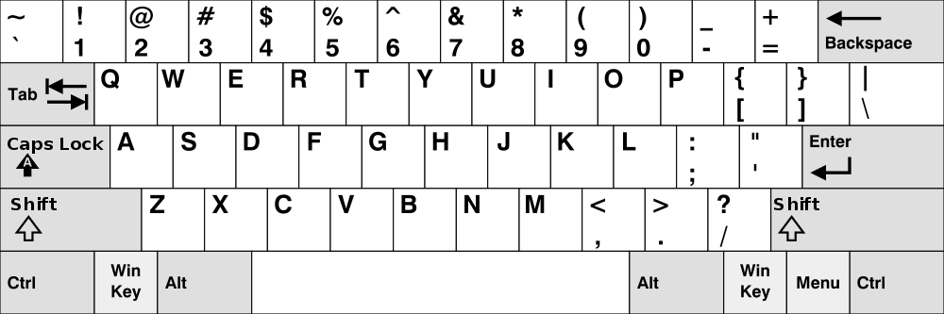
Vietnamese
IME: Unikey (or similar)
No dictionary required
Optimized for ANSI keyboard
Telex

Slide 15
A final note
You can (not) really picky about keyboard layout.
Each country will sell their respective (physical) keyboard layout
There are some languages without IME nor physical keyboard.
For accuracy, please ask native speakers how they type on PC
Difference OS utilize different software
For Windows: there are many softwares
For Apple macOS: mac’s own input sources
For Linux: SCIM, ibus or fcitx
The illustrations you see on some electronic stores websites are not accurate
Bad designs do exist
Apple and Windows keyboard layouts are slightly different
Incorrect information do exist
Notes:
Open netonnet, MediaMark

Slide 16
End

Slide 17
Credits
A typical keyboard: Simo Kaupinmäkis (Wikipedia)
Keyboard layout comparisons: Wikipedia
Real keyboards
Logitech
K270 ANSI: Evan Huynh
K270 JIS: http://xahlee.info/kbd/tiny_space_bar_japanese_keyboard.html
K270 ISO (UK): https://www.gumtree.com/p/keyboards-keypads/logitech-wireless-keyboard-k270-uk-layout/1295481524

Slide 18
Credits
Input methods information
Keyboard languages
Chinese: Google (Google Translate logo), RIME IME, Microsoft (Pinyin IME screenshot), Apple (System Preferences/Keyboard/Input Sources), Yi-Chia Lee (Apple MacBook Pro keyboard), Youwen Zhang (Chinese IME info)
Japanese: Yume Hoashi (keyboard), Microsoft (Translator logo), Google (Japanese Input), Yes0song (chart)
Korean: Kyungjin Kim (keyboard), Microsoft (IME), Wikipedia (keyboard layout)
Vietnamese: Lam (keyboard), Kim Long Pham (Unikey screenshot), Wikipedia (US keyboard layout)

